Slide 1

Diagnose your Golang App anytime anywhere!
Mateusz Dymiński

Slide 2
Whoami
Mateusz Dymiński
Software Developer at Nokia
9+ exp with Java
5+ exp with Go
One of the organizer GoWroc - Golang Wroclaw Meetup
Github: github.com/mateuszdyminski
Twitter: @m_dyminski
LinkedIn: linkedin.com/in/mdyminski

Slide 3
Agenda
Debugging
Profiling
Tracing
Instrumentation

Slide 4
REST
func (r *UserRest) Users(w http.ResponseWriter, req *http.Request) {
rows, err := r.db.Query("SELECT * FROM users")
if err != nil {
WriteErr(w, err, http.StatusInternalServerError)
return
}
users := make([]User, 0, 0)
for rows.Next() {
var uid int
var firstName, secondName string
var birthDate time.Time
err = rows.Scan(&uid, &firstName, &secondName, &birthDate)
if err != nil {
WriteErr(w, err, http.StatusInternalServerError)
return
} users = append(users, User{ID: uid, FirstName: firstName, SecondName: secondName, BirthDate: birthDate})
}
if rows.Err() != nil {
WriteErr(w, rows.Err(), http.StatusInternalServerError)
return
}
WriteJSON(w, users)
}

Slide 5
Demo Users Service
Run
$ go run main.go --db-pass=password --db-host=192.168.99.101:31125
http://localhost:8080/api/users
apiVersion: v1
kind: Service
metadata:
name: users-go-api
spec:
type: NodePort
ports:
- port: 8080
nodePort: 31001
selector:
app: users-go-api

Slide 6

github.com/mateuszdyminski/go-diagnose

Slide 7
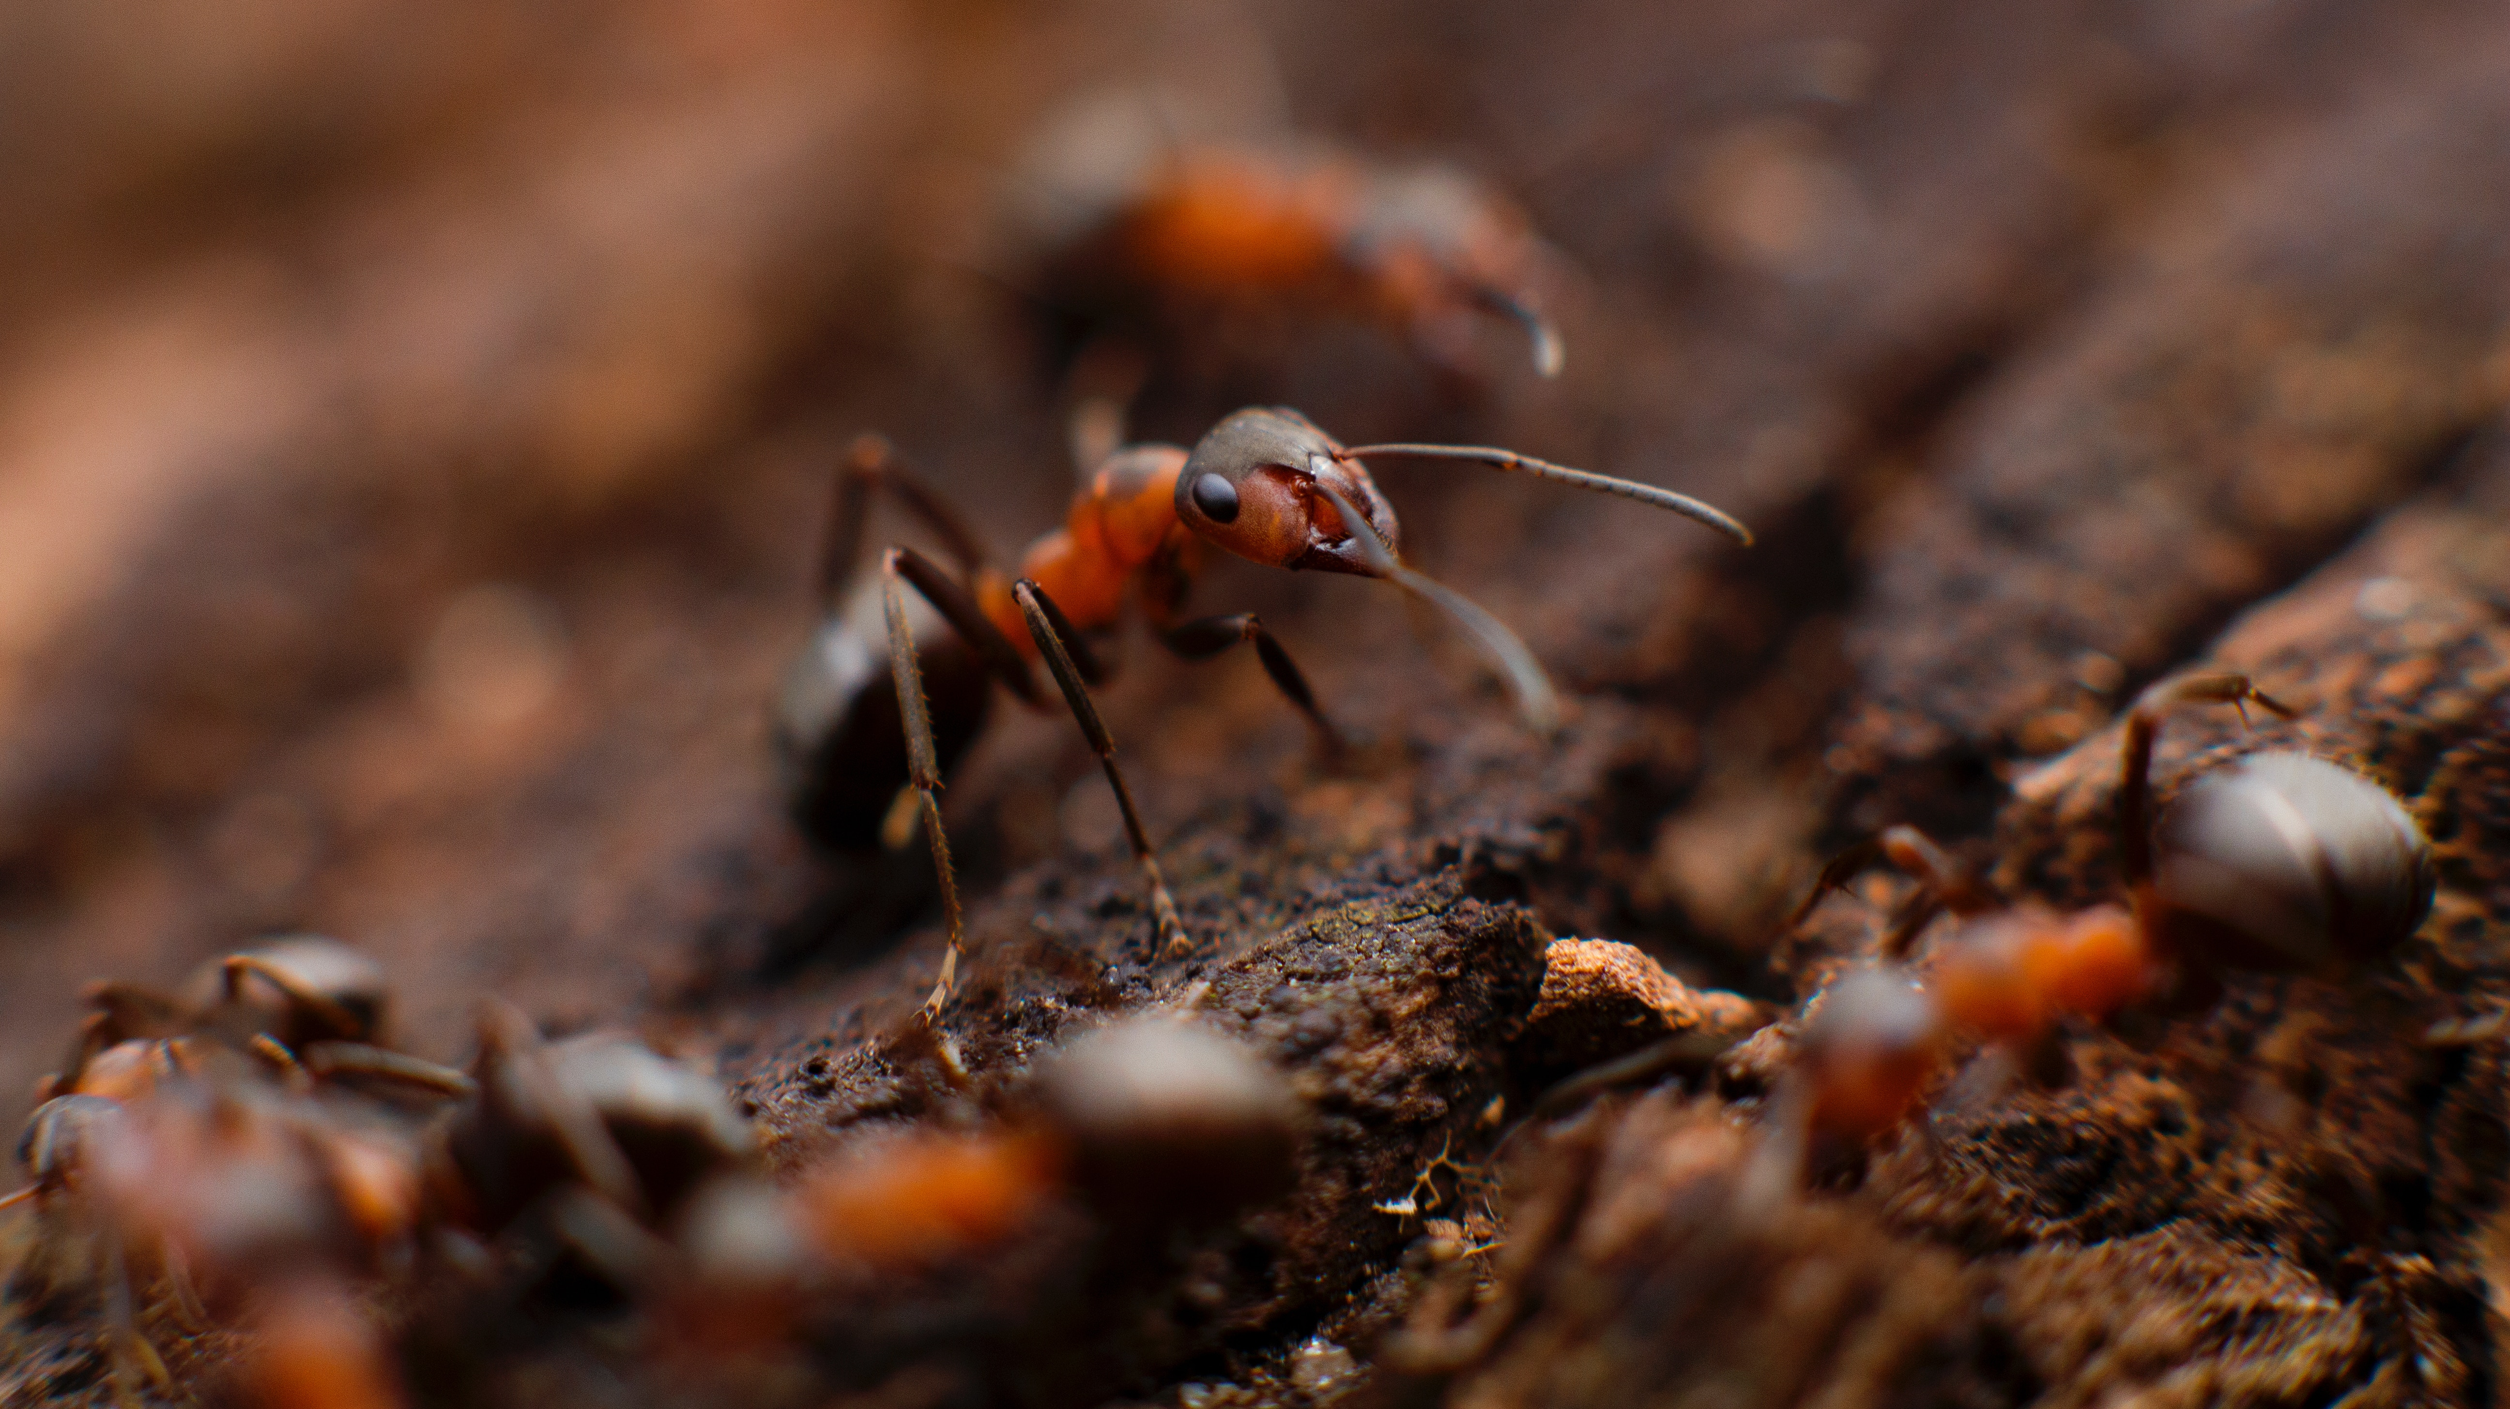
Debugging

Slide 8

Profiling

Slide 9

Tracing

Slide 10
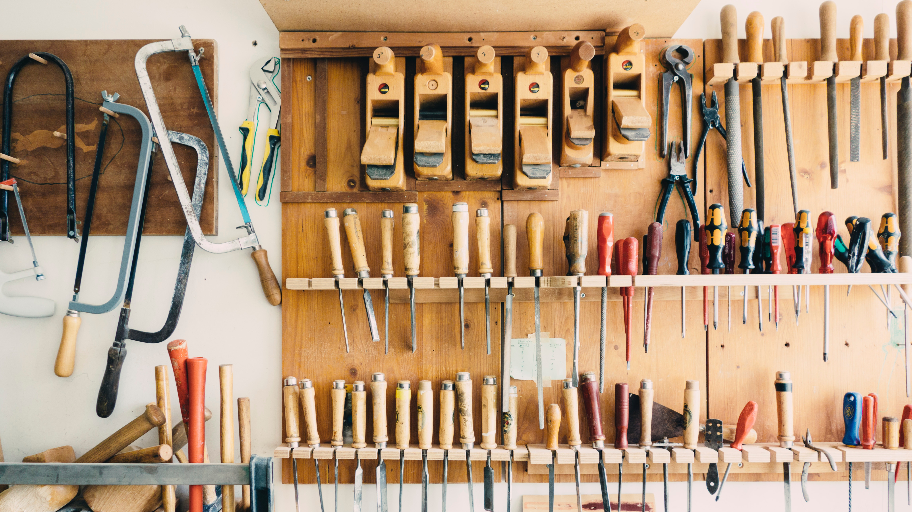
Instrumenting

Slide 11
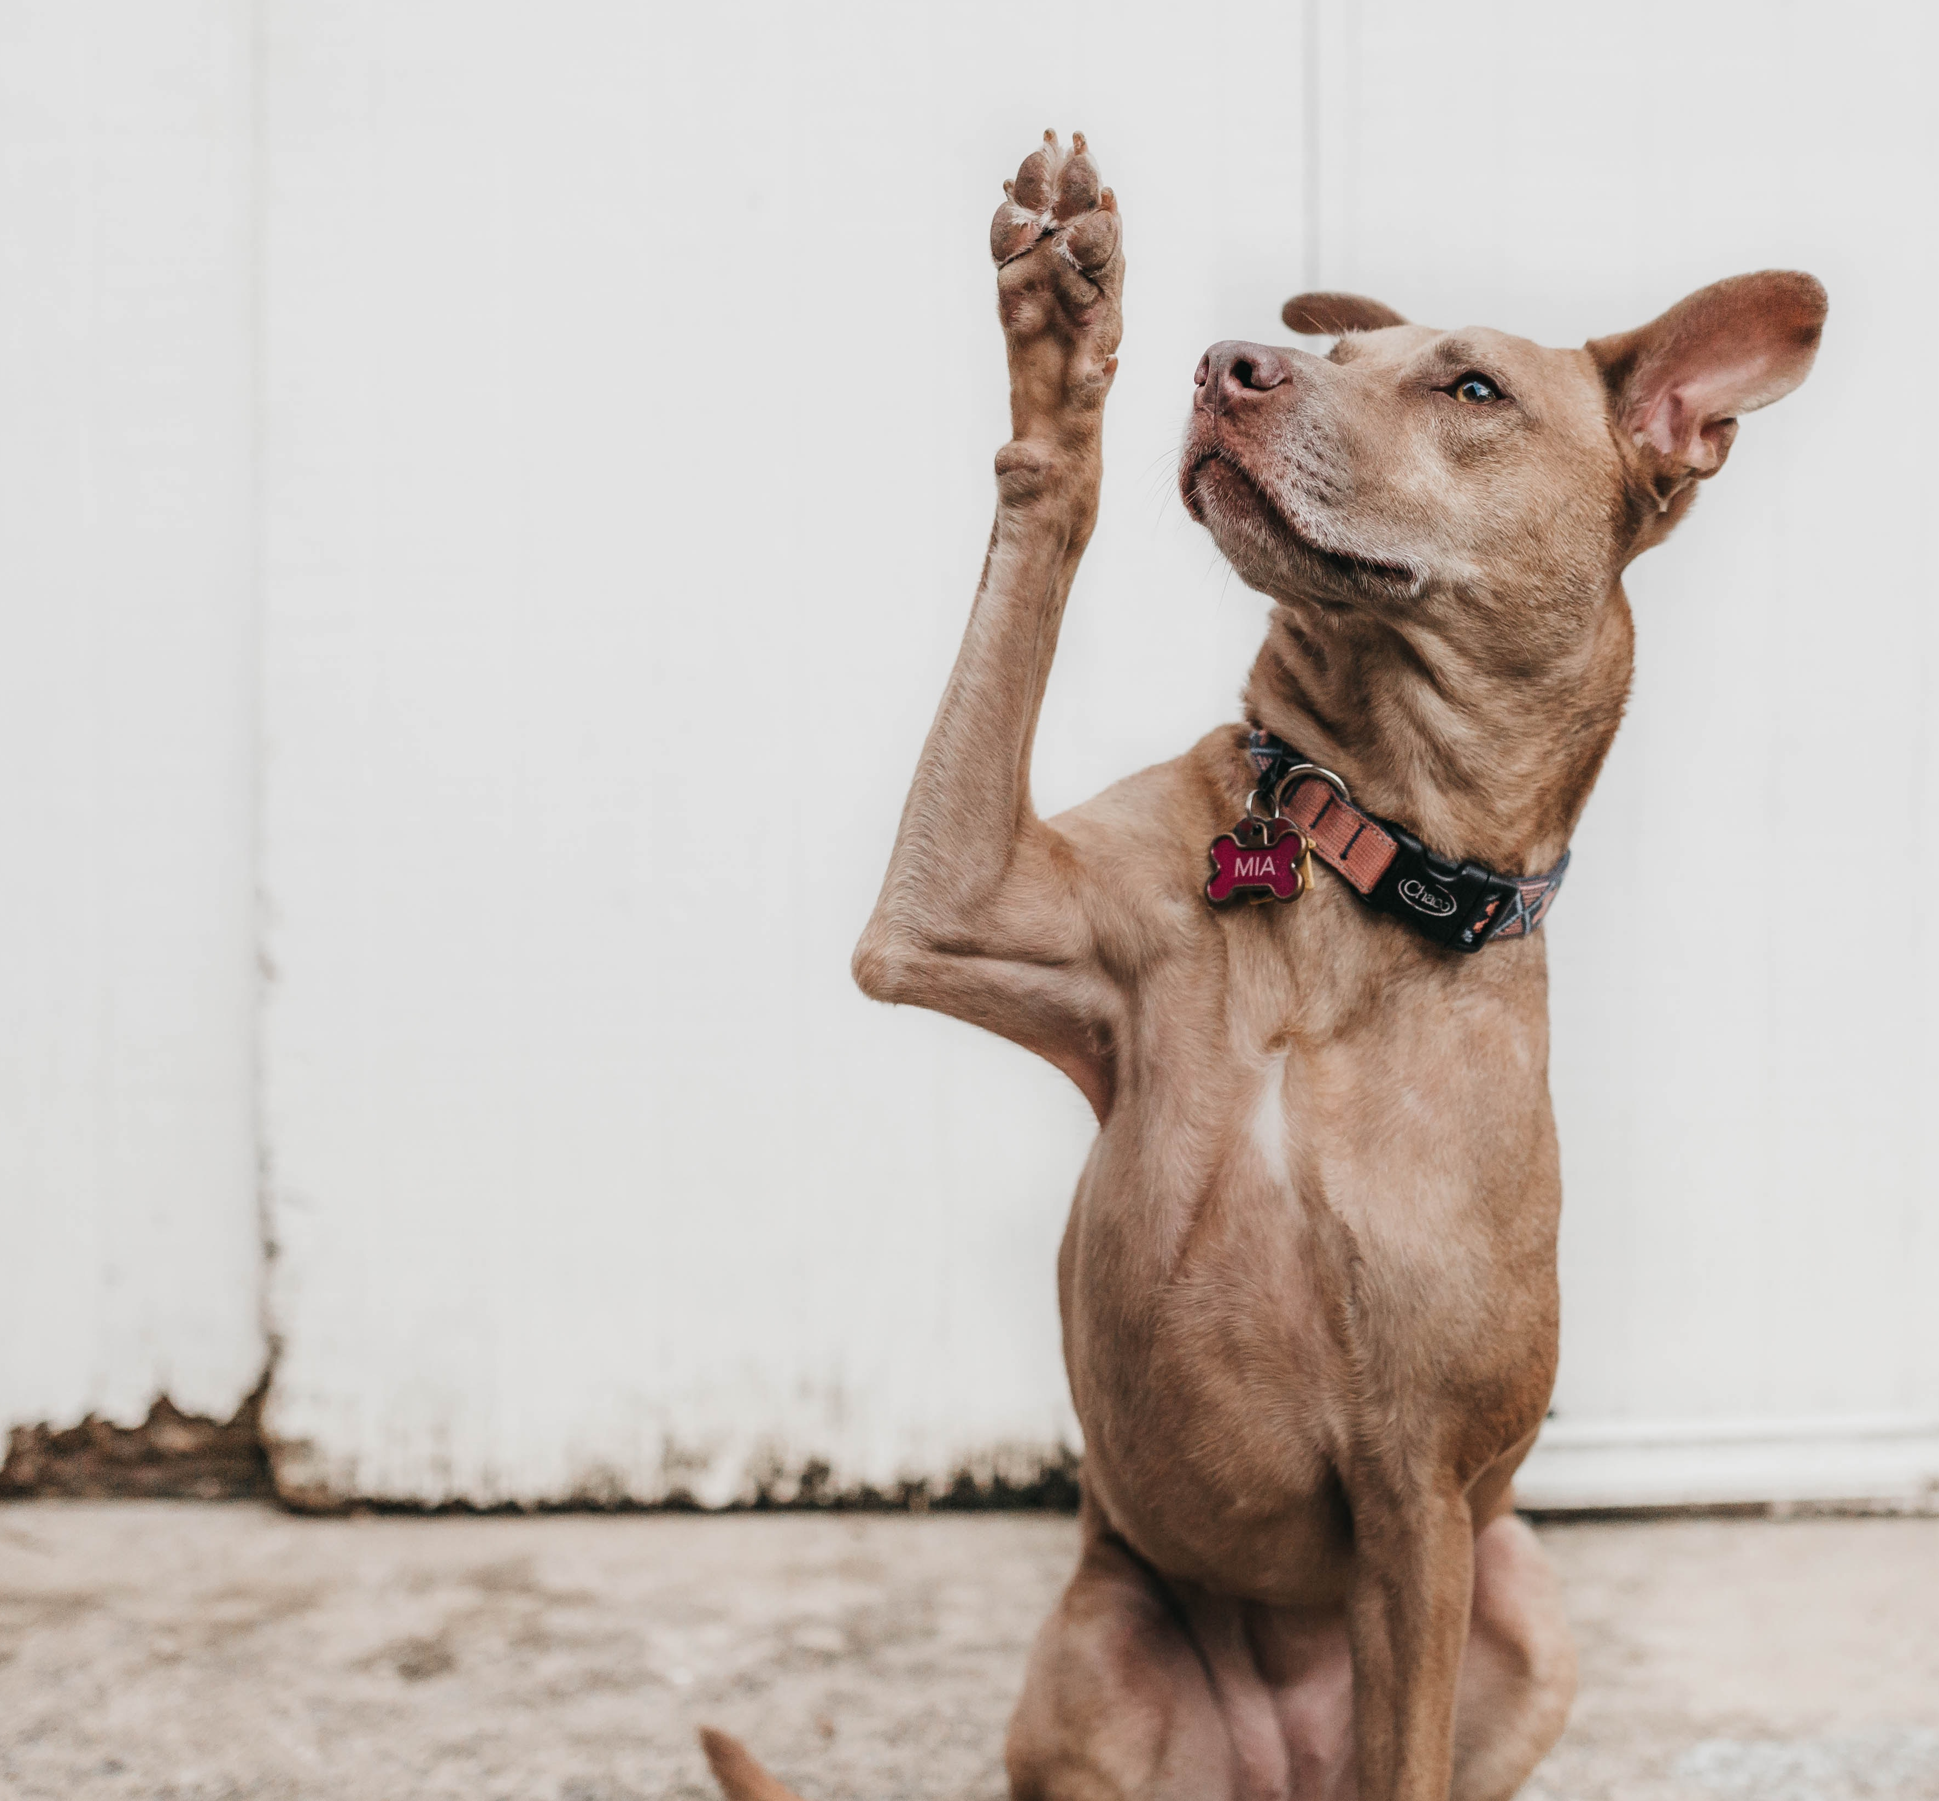
Q&A

